Slide 1
Fundamentals of Data Representation Lesson 1
Binary

Slide 2
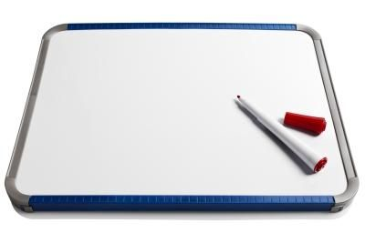
Put these into Size Order – 30 secs
Megabyte (Mb)
Terabyte (Tb)
Kilobyte (Kb)
bit
Byte
Gigabyte (Gb)

Slide 3
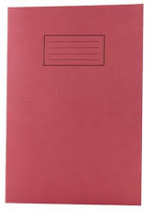
Data Storage Capacities
bit (a single 0 or 1 is a binary digit)
8 bits = 1 byte
1024 bytes = 1Kb
1024 Kilobytes = 1Mb
1024 Megabytes = 1Gb
1024 Gigabytes = 1Tb
Did you know?
Half a byte (4 bits) is called a
nibble?

Slide 4
Why 1024? It’s Binary! 0 and 1’s!
2^0 = 1
2 ^ 1 = 2
2 ^ 2 = 4
2 ^ 3 = 8
2 ^ 4 = 16
2 ^ 5 = 32
2 ^ 6 = 64
2 ^ 7 = 128
2 ^ 8 = 256
2 ^ 9 = 512
2 ^ 10 = 1024

Slide 5
Learning Objectives
To understand that computers use the binary alphabet to represent all data and instructions.
Understand the terms bit, nibble, byte, kilobyte, megabyte, gigabyte and terabyte
Success Criteria
Will be able to state what binary is.
Will be able to explain how computers use binary and do simple binary conversions.
Will create a spreadsheet that automatically works out denary number from a given binary number.

Slide 6
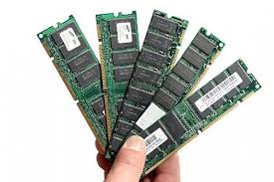


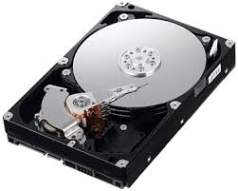
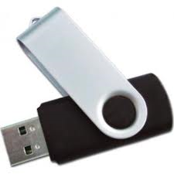

Rank these types of data storage in size
RAM
4-8Gb
700Mb
128Gb
Hard Drive
4Tb
256Gb
4.7Gb

Slide 7
How Computers Work – Binary!
Computers are made up of complicated hardware that stores and processes data.
If you break a computer down into its most basic components you have millions of circuits that either allow electricity to flow, or not.
Imagine a whole row of light switches that you can switch on and off in different combinations to mean different things.
Each switch is either on or off. It only has two states. That is why everything stored in a computer can be stored as a series of 1s and 0s. This is called binary.

Slide 8
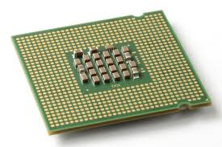
CPU / Processor/ Chip
The CPU is the brain of the computer – it tells the computer what to do and when.
Has millions of tiny switches that can either be:
on or off
1 or 0
Notes:
Why is it just 0 and 1? Electricity is on or off!

Slide 9
Denary System
0 , 1, 2, 3, 4, 5, 6, 7, 8, 9
We use a number system that uses 10 different numbers. (Base 10 number system)
This is called the Denary System.
However computers don’t understand this as they only understand 0’s and 1’s.
on or off

Slide 10
Denary System
Working Denary Out
243
3 units

Slide 11
Denary System
Working Denary Out
243
4 tens
4 * 10 = 40

Slide 12
Denary System
Working Denary Out
243
2 hundreds
2 * 100= 200

Slide 13
Denary System
Working Denary Out
2 hundreds
2 * 100= 200
4 tens
4 * 10 = 40
+
+
3 units
=
243

Slide 14
Binary
Computers understand binary which is a Base 2 number system as it only has two numbers:
0 and 1

Slide 15
Binary
The position of numbers in binary is also important.
Calculating denary number 1:
x2
x2
x2
x2
x2
x2
x2
Denary | 128 | 64 | 32 | 16 | 8 | 4 | 2 | 1
Binary | 0 | 0 | 0 | 0 | 0 | 0 | 0 | 1
(1 * 1) = 1
Binary = 00000001

Slide 16
Binary
The position of numbers in binary is also important.
Calculating denary number 3:
Denary | 128 | 64 | 32 | 16 | 8 | 4 | 2 | 1
Binary | 0 | 0 | 0 | 0 | 0 | 0 | 1 | 1
+
(1 * 2) = 2
(1 * 1) = 1
Binary = 00000011

Slide 17
Binary
The position of numbers in binary is also important.
Calculating denary number 6:
Denary | 128 | 64 | 32 | 16 | 8 | 4 | 2 | 1
Binary | 0 | 0 | 0 | 0 | 0 | 1 | 1 | 0
+
(1 * 4) = 4
(1 * 2) = 2
Binary = 00000110

Slide 18
Binary
The position of numbers in binary is also important.
Calculating denary number 37:
Denary | 128 | 64 | 32 | 16 | 8 | 4 | 2 | 1
Binary | 0 | 0 | 1 | 0 | 0 | 1 | 0 | 1
+
+
(1 * 32) = 32
(1 * 4) = 4
(1 * 1) = 1
Binary = 00100101

Slide 19
Binary
Can you work out how to write the denary number 115 in binary?
Denary | 128 | 64 | 32 | 16 | 8 | 4 | 2 | 1
Binary | 0 | 1 | 1 | 1 | 0 | 0 | 1 | 1
+
+
+
+
64
32
16
2
1
Binary = 01110011

Slide 20
Binary
Can you work out how to write the denary number 255 in binary?
Denary | 128 | 64 | 32 | 16 | 8 | 4 | 2 | 1
Binary | 1 | 1 | 1 | 1 | 1 | 1 | 1 | 1
+
+
+
+
+
+
+
128
64
32
16
8
4
2
1
Binary = 11111111

Slide 21
Tip – Always use 8 bits for binary!
So far we have only looked at numbers using eight columns. This is an 8-bit number, or a byte.
00000011 is binary for 3 but so is 11.
You do not need the leading zeros for it to be a valid number but we tend to write groups of 8 bits because computers usually store data in bytes.

Slide 22
Binary Task
Work out the following numbers in binary:
Number | Binary
165
117
61
224
39
139
170
186
255
223
84

Slide 23
Binary Task - Answers
Work out the following numbers in binary:
Number | Binary
165 | 10100101
117 | 01110101
61 | 00111101
224 | 11100000
39 | 00100111
139 | 10001011
170 | 10101010
186 | 10111010
255 | 11111111
223 | 11011111
84 | 01010100

Slide 24
Extension
Can you create a spreadsheet that will automatically work out the denary number from the binary you type in (or vice versa?)
Validate it so you can only enter a 0 or 1

Slide 25
Review
What is binary? Explain this as if you are explaining this to someone who knows nothing about it.

